Slide 1
Warehouse Record Management System
Shrikrishna Subhas Nayak – 002246781
Madhu Sai Kalyan Kaluri – 002248753
Ujwal Chandrashekar – 002193079
Preyash Amar Mehta – 002291343
Shubh Patel – 002822971
Team Members:

Slide 2
Goal and Objectives
Centralized WMS database for real-time inventory tracking and proactive stock replenishment.
Streamlined order fulfillment, automated communication, and data-driven inventory planning.
Robust access controls, data security, and integrity for warehouse information.

Slide 3
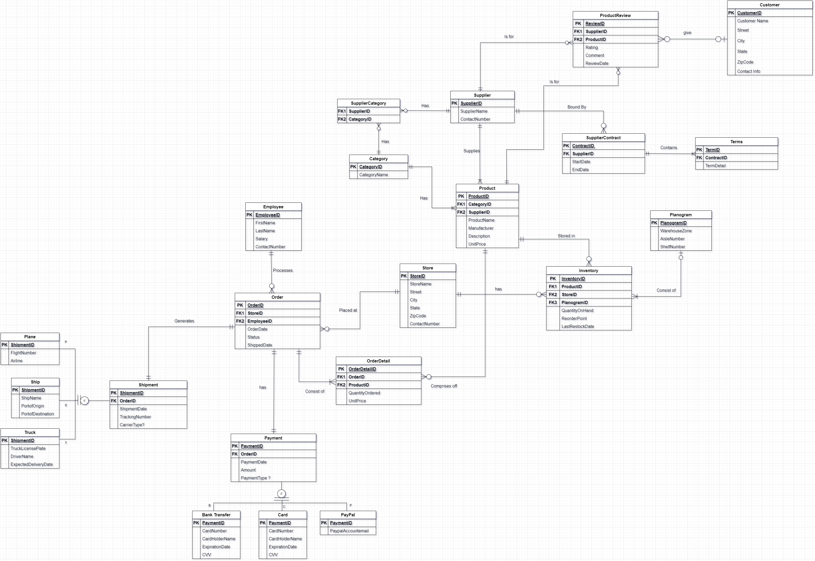
Final ER Diagram

Slide 4
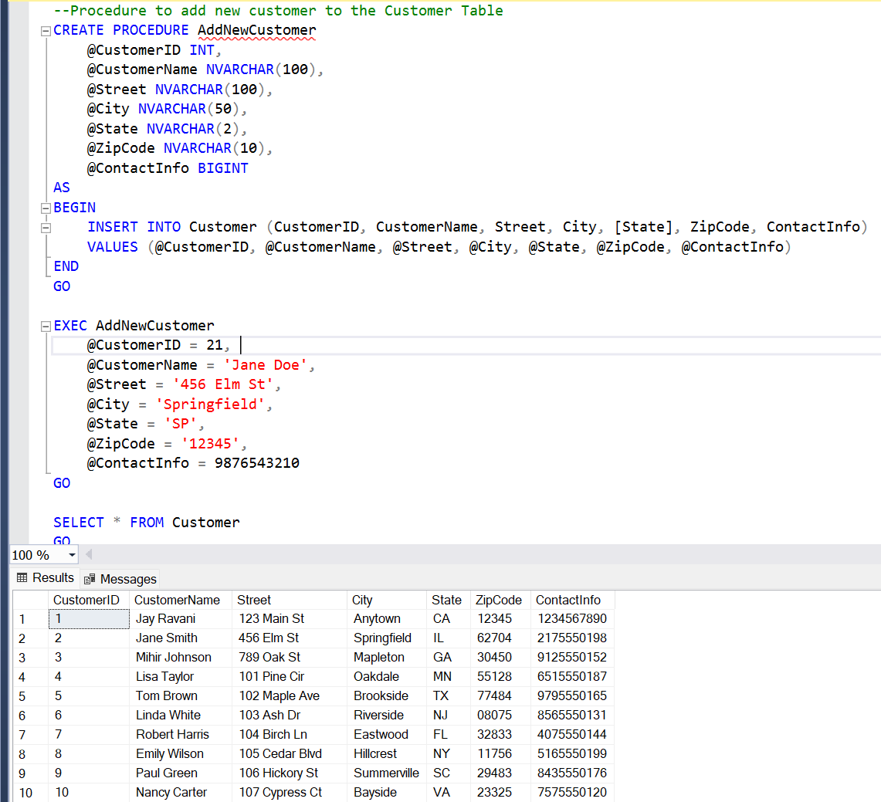
Stored Procedures

Slide 5
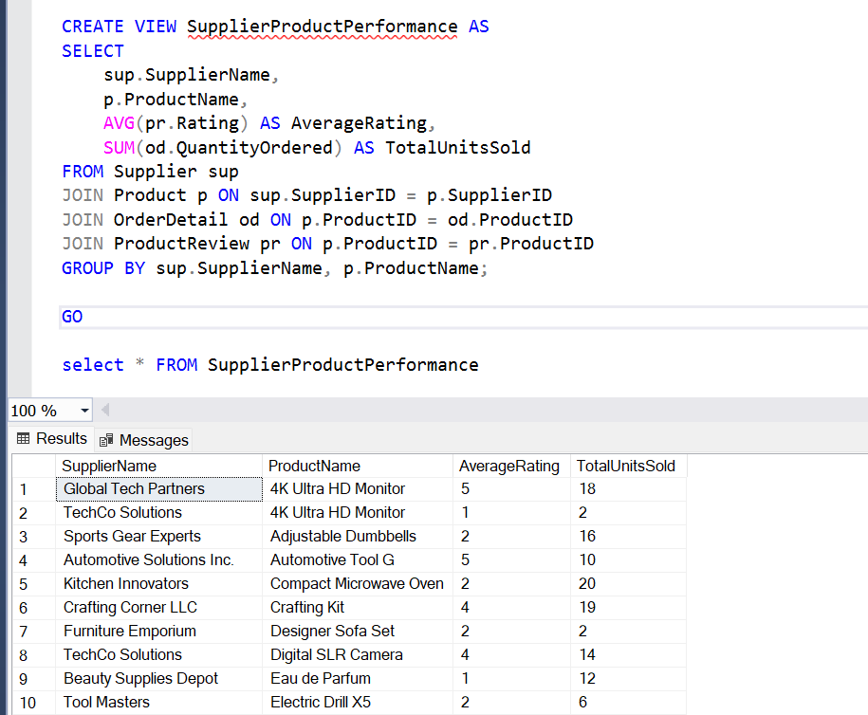
Views

Slide 6
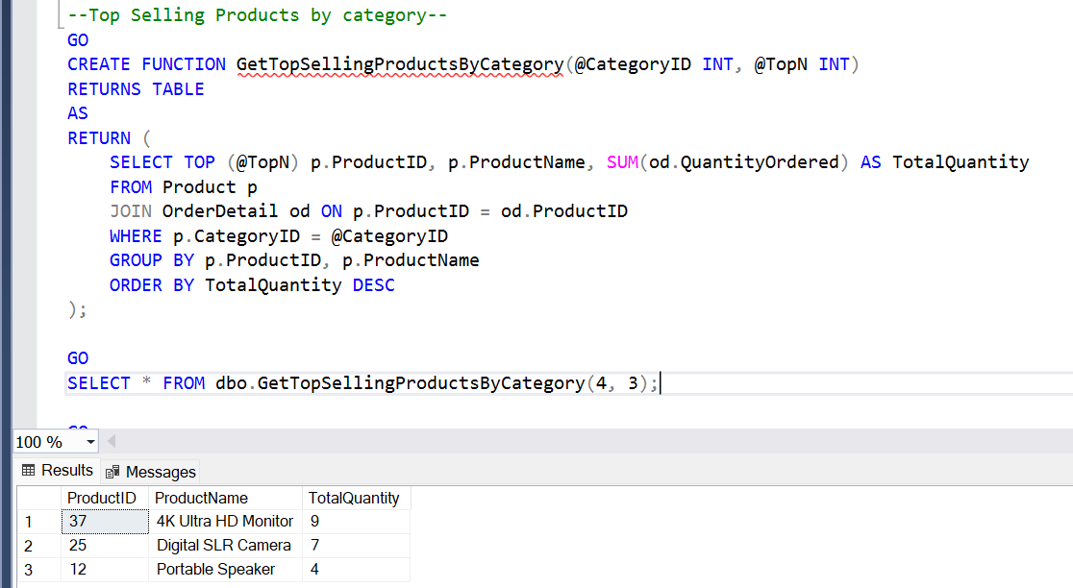
Non-Computed UDF’s

Slide 7
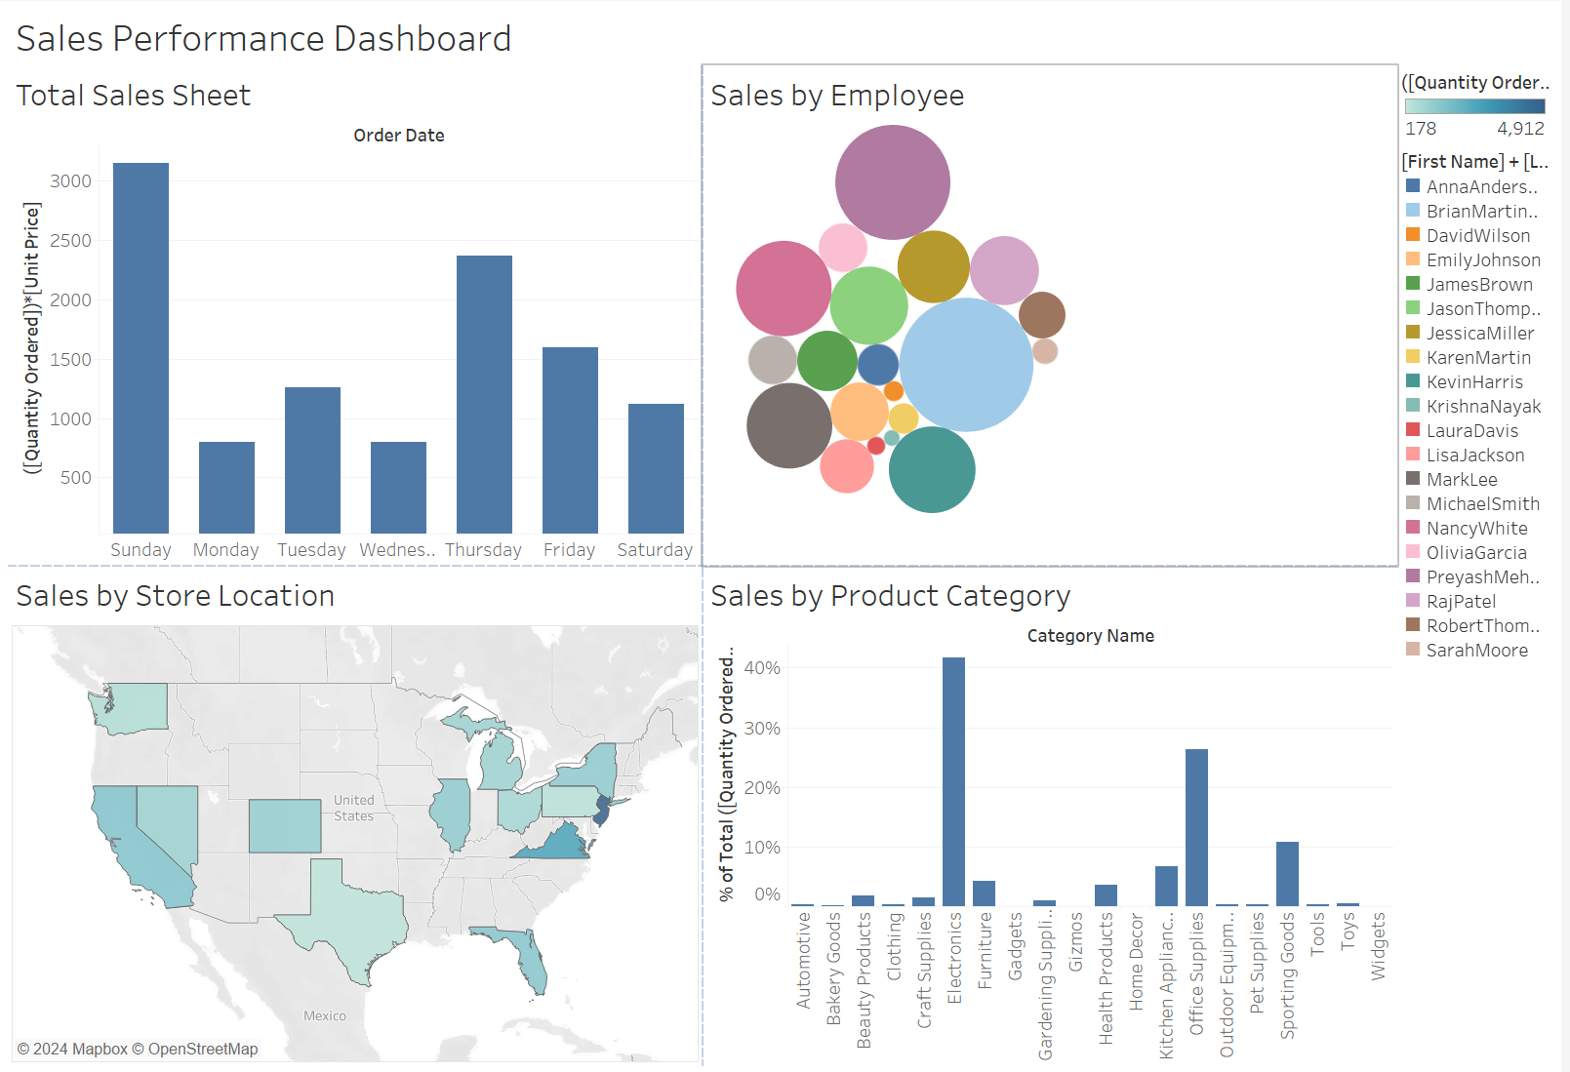
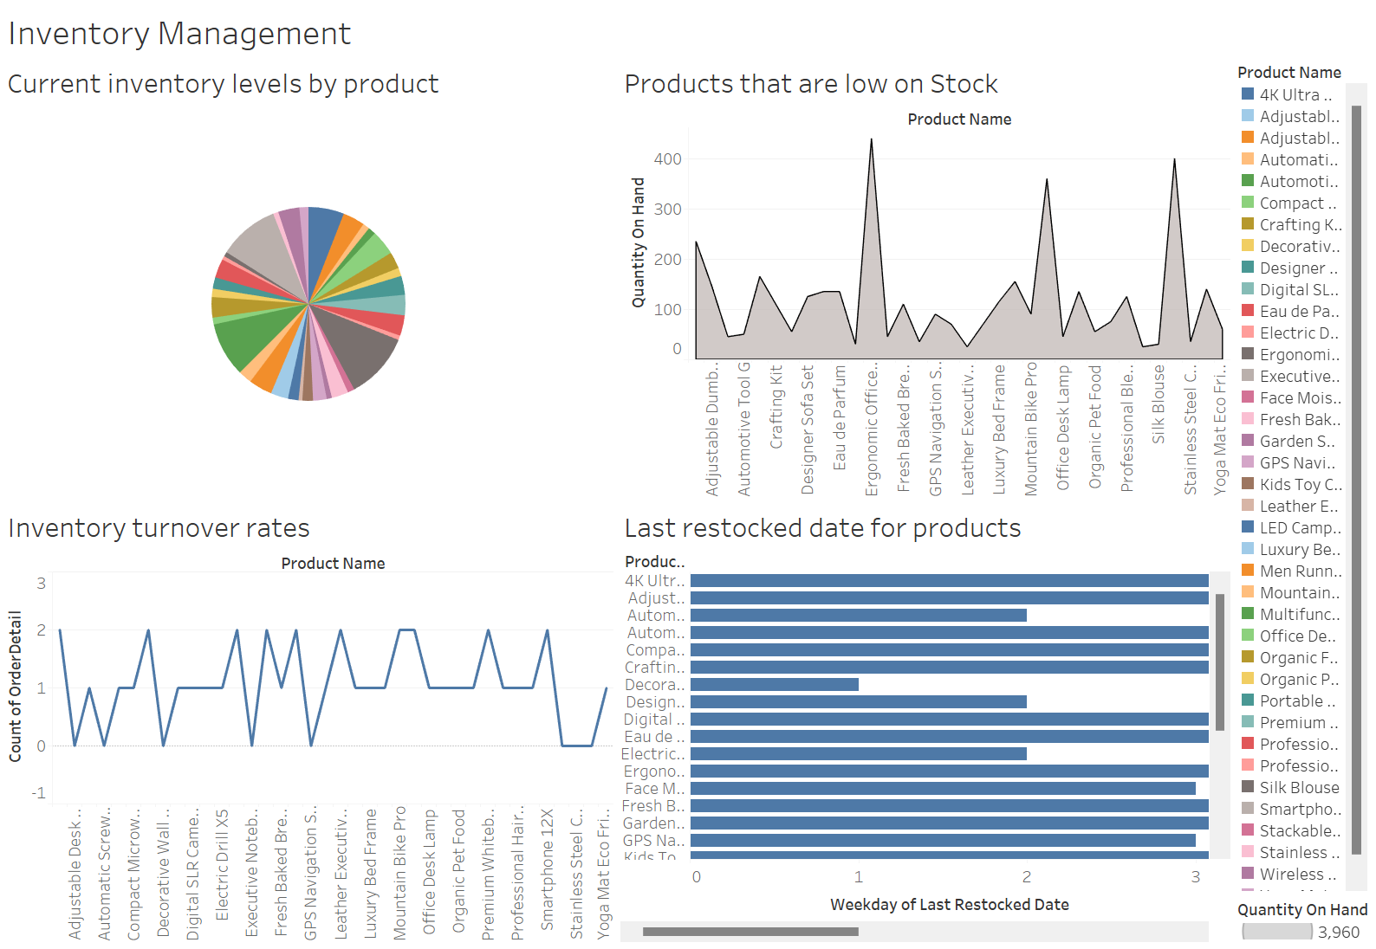
Data Visualization

Slide 8
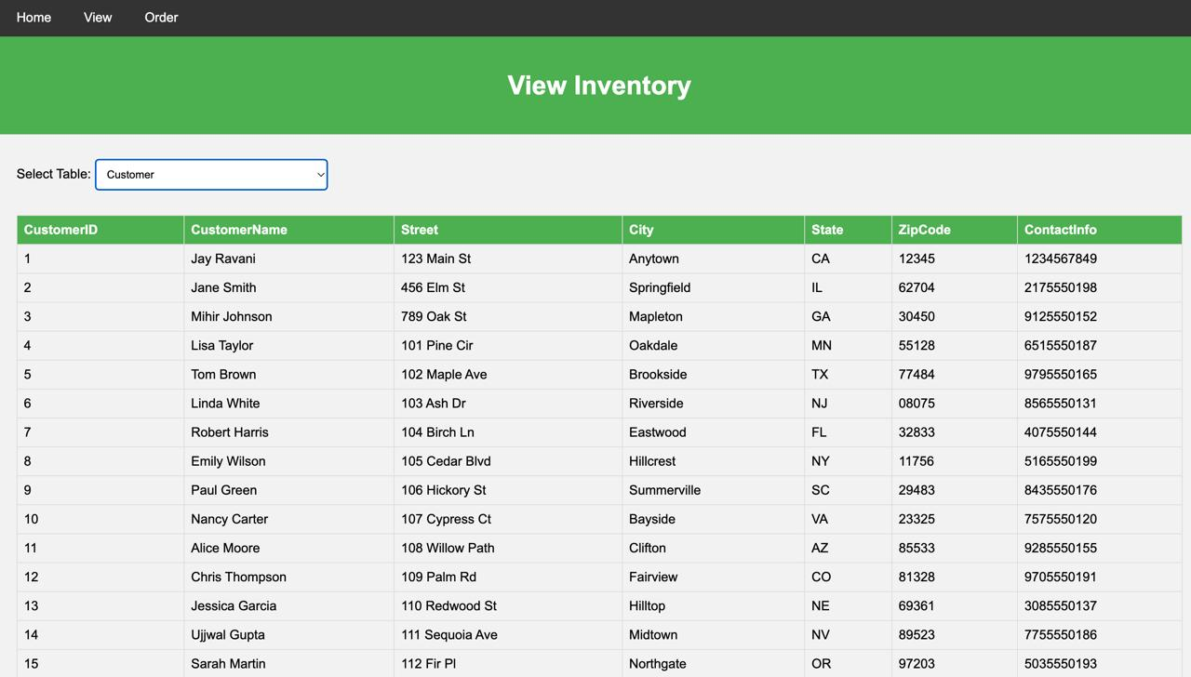
GUI – Inventory Table

